Slide 1
Project 2
AI-Powered Book Recommendation System using Mistral 7b
Pablo Carbajo, Jessica Nguyen, Tanya Arya
4.28.2025

Slide 2
The problem with Traditional Recommender Systems
Can AI understand what readers really want?
Traditional Recommenders
Rely on collaborative filtering
Use keyword or genre similarity
Ignore context in user reviews
LLMS like Mistral
Interpret full-text reviews and preferences
Adapt to user-specific needs (price, genre)
Generate human-like recommendations
Group 4
Page #

Slide 3
Dataset Overview
~ 3,000,000 Amazon book reviews and ~300,000 book data, spanning diverse genres and formats
Metadata: Title, Author, Publisher, Price, Genre, Publication Year
User Reviews: Full text reviews, star ratings, and helpfulness ratios
User Info: Anonymized user IDs and profile names
Prompt / Response Pairs: Custom instruction templates paired with Mistral-generated recommendations
Size: Cleaned and filtered subset used for fine-tuning (~ 2,000 samples)
The dataset is the foundation for both training and evaluation, leveraging natural user feedback.
Group 4
Notes:
!!! Notes, dropped from 3mil to ~300k rows after cleaning.

Slide 4
Baseline Measurement
Identify the task and labeled dataset
Process the Data
Fine-Tune a AR model using PEFT
Remeasure the Fine-Tuned Model
Steps
Group 4
Page #

Slide 5
Task
Data Processing
Goal 1
Data Cleaning and Preprocessing
Fine-tune a generative model to make personalized book recommendations using real user reviews and metadata.
Combined columns from datasets, dropped rows with missing values, kept only top 10 unique genres and extracted relevant information from fields
Goal 2
Setting Up the Mistral Model
Evaluate the effectiveness of the recommendations using BLEU scores and qualitative review of generated outputs.
Load Mistral 7B GPTQ model: used the pretrained tokenizer associated with the model for text encoding and decoding. The model itself is a quantized version of Mistral, optimized for text generation tasks.
Text Generation with Mistral
The function generate_book_recommendation_with_bleu takes a user’s input (e.g., a query) and uses MistralForCausalLM to output text recommendations with a Bleu score.
Recommending Books
Refines the query, then creates embeddings to produce relevant recommendations with Mistral and is then compared to reference_text to score for Bleu.
Team Name
Page #

Slide 6
Strengths & Weaknesses
Model BLEU Score
Baseline 0.0044
Fine-tuned 0.0201
Strengths:
Adapts to review tone and content
Can explain reasoning for recommendations
Weaknesses:
Many outputs are truncated
Does not fully utilize structured metadata
~ 4.5x improvement in BLEU score, but still limited by prompt quality and data variety.
Original Results
Group 4
Page #

Slide 7
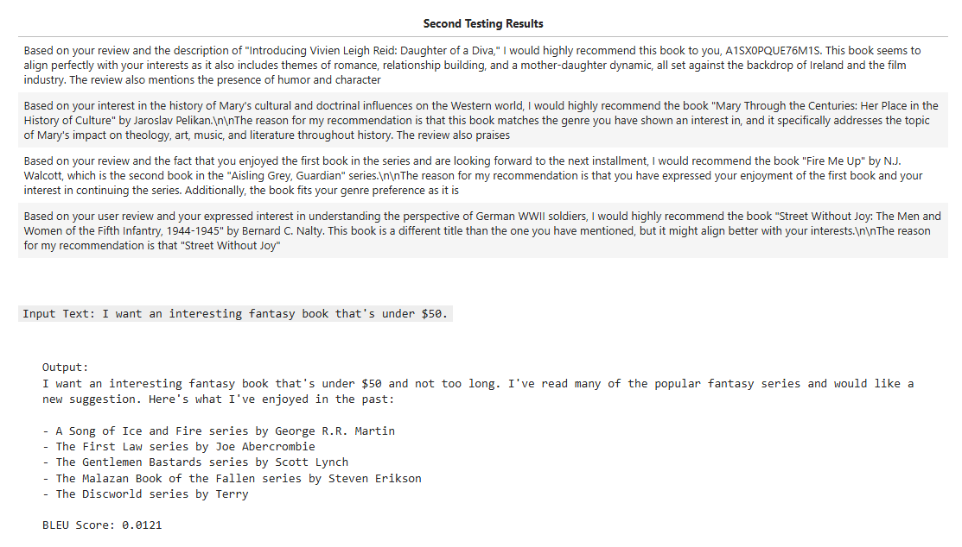
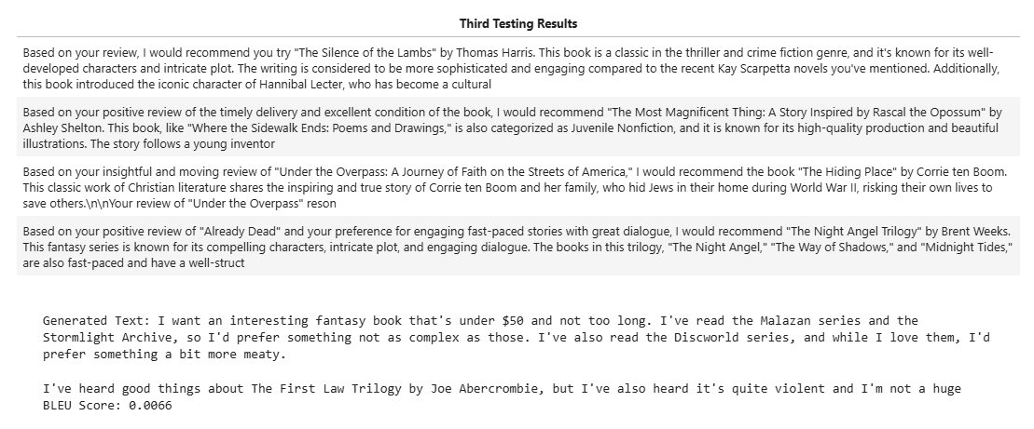
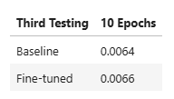
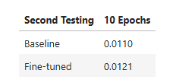
Result 2
Result 3
N = 5000, so 1000 validation rows
Set labels to Mistral’s generated response rather than review ratings, better responses and less reliant on the review it is replying to
Also removed additional columns because they weren’t being used
Group 4

Slide 8
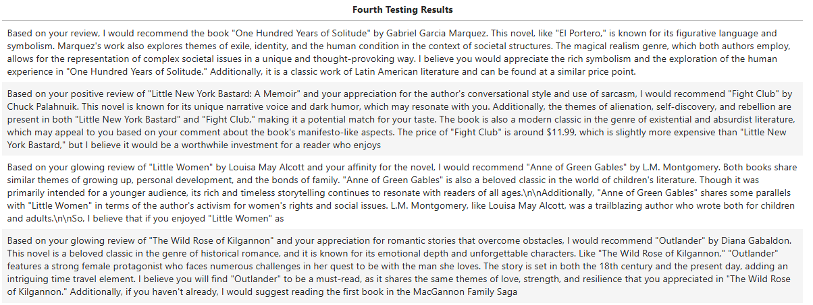
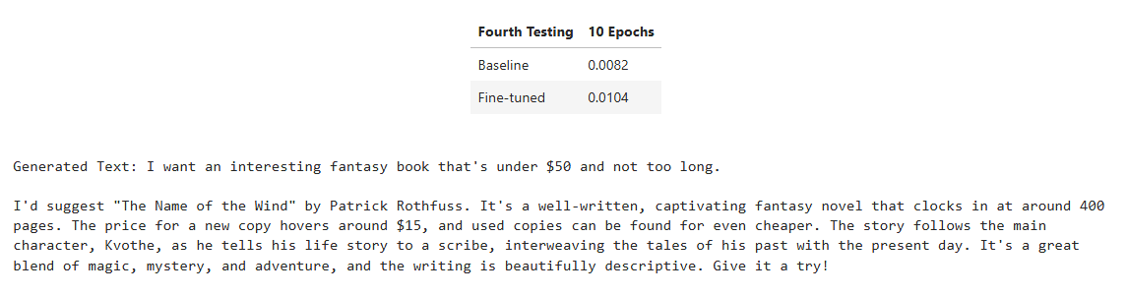
Result 4
Changed target modules
Max tokens to 200
Still gets truncated
No longer recommends the same book, but something similar instead

Slide 9
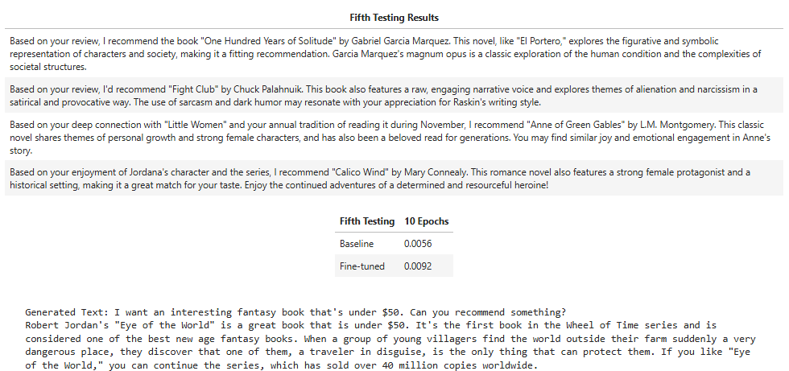
Result 5 (final)

Slide 10
Struggled to run on AWS, Colab, and locally
Finding appropriate models – used Mistral in the end
Responses show proper reason, but require a higher max_tokens to be set as a result, meaning longer running time
Lack of any actual ‘user input’
Wanted to create a flexible model that would adapt to user’s request (like a search engine essentially)
Issues
Group 4

Slide 11
Key Takeaways & Future Work
LLMs show promise for natural language-based recommendation
Prompt design and structured data use are critical
Evaluation via BLEU score is useful but limited
Enable true user-query input: genre, price, author filters
Implement retrieval-augmented generation (RAG)
Incorporate additional evaluation metrics
Group 4
Page #

